Slide 1




University of Information Technology and Communications
Business Informatics College
Businesses Information Technology (BIT)
HTML
Yasser alasady & Dr. reem

Slide 2
Outline
HTML Tables
Tables are defined with the <table> tag. A table is divided into rows (with the <tr> tag), and each row is divided into data cells (with the <td> tag). The letters td stands for "table data," which is the content of a data cell. A data cell can contain text, images, lists, paragraphs, forms, horizontal rules, tables, etc.
<table border="1"> <tr>
<td>row 1, cell1</td>
<td>row 1, cell 2</td> </tr>
<tr>
<td>row 2, cell 1</td> <td>row 2, cell 2</td> </tr> </table>

Slide 3
Outline
Tables and the Border Attribute
If you do not specify a border attribute the table will be displayed without any borders. Sometimes this can be useful, but most of the time, you want the borders to show.
To display a table with borders, you will have to use the border attribute:
<table border="1">
<tr>
<td>Row 1, cell 1</td> <td>Row 1, cell 2</td> </tr>
</table>

Slide 4
Outline
Headings in a Table
Headings in a table are defined with the <th> tag.
<table border="1">
<tr>
<th>Heading</th> <th>Another Heading</th> </tr>
<tr>
<td>row 1, cell 1</td> <td>row 1, cell 2</td>
</tr>
<tr>
<td>row 2, cell 1</td> <td>row 2, cell 2</td>
</tr>
</table>

Slide 5
Outline
Empty Cells in a Table
Table cells with no content are not displayed very well in most browsers.
<table border="1">
<tr>
<td>row 1, cell 1</td>
<td>row 1, cell 2</td> </tr>
<tr>
<td>row 2, cell 1</td> <td></td>
</tr>
</table>

Slide 6
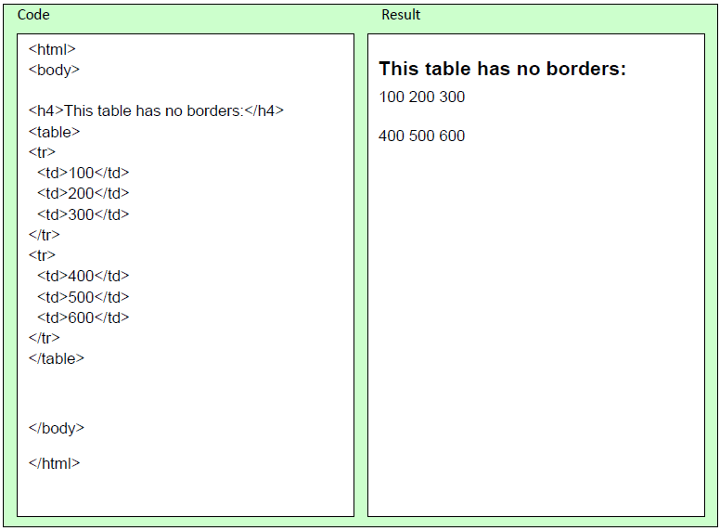
Outline
More Examples
The following example demonstrates a table with no borders

Slide 7
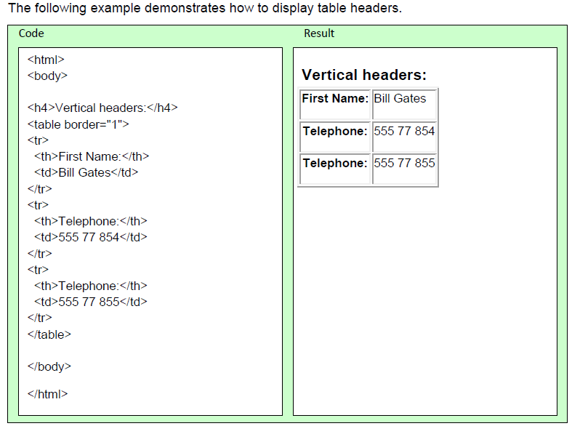
Outline
Examples

Slide 8
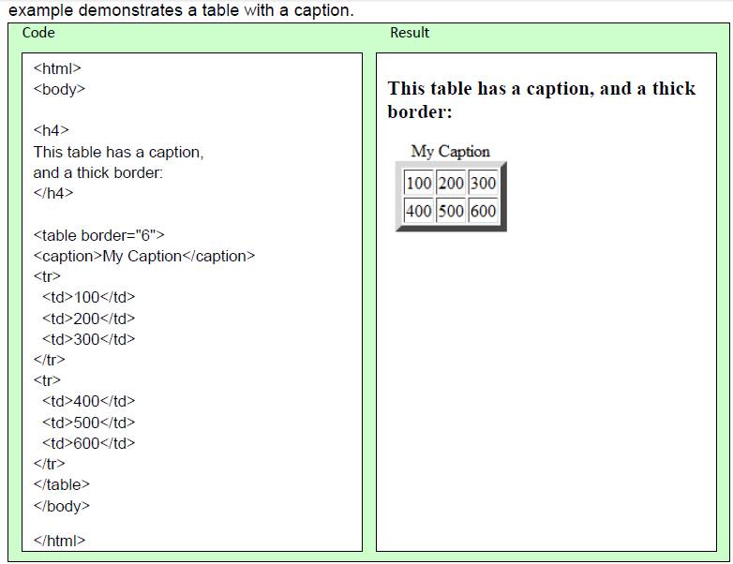
Outline
Examples

Slide 9
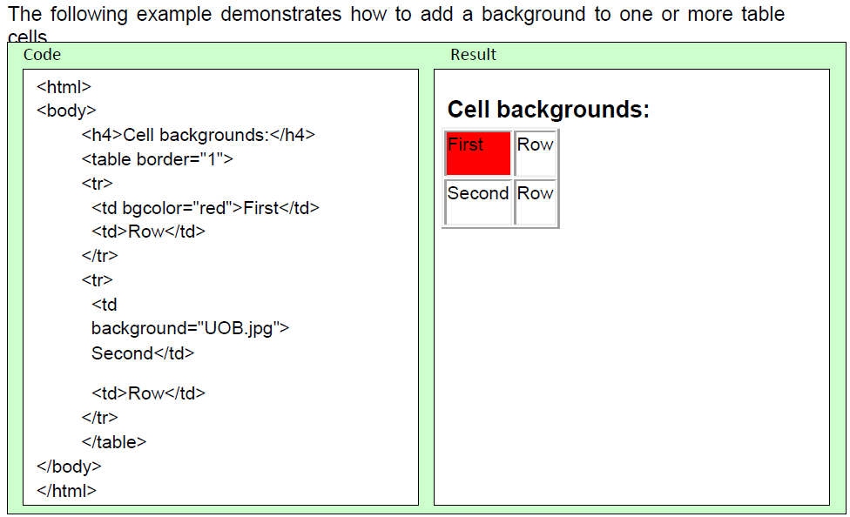
Outline
Examples

Slide 10
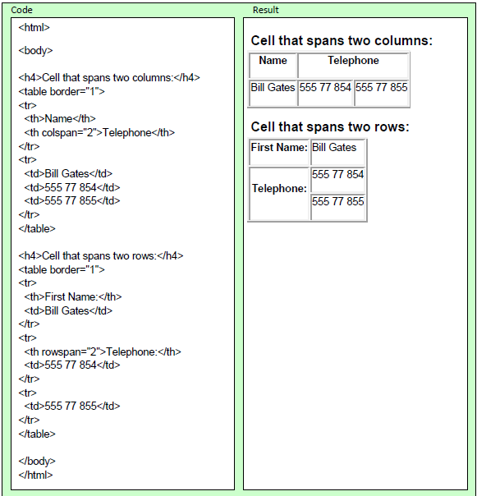
Outline
Examples
The following example demonstrates how to define table cells that span more than one row or one column.

Slide 11
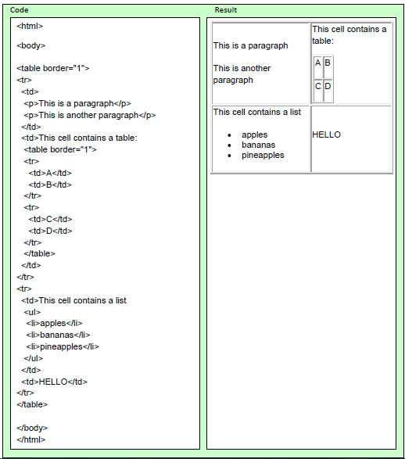
Outline
Examples
The following example demonstrates how to display elements inside other elements.

Slide 12
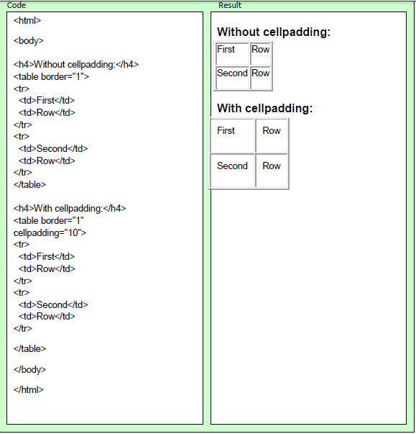
Outline
Examples
The following example demonstrates how to use cell padding to create more white space between the cell content and its borders.

Slide 13
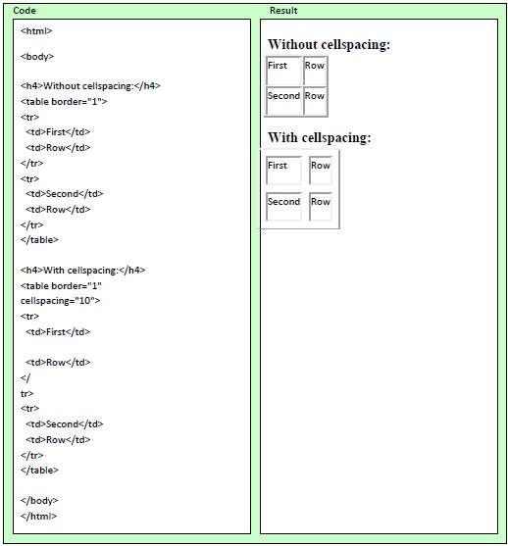
Outline
Examples
The following example demonstrates how to use cellspacing to increase the distance between the cells.

Slide 14
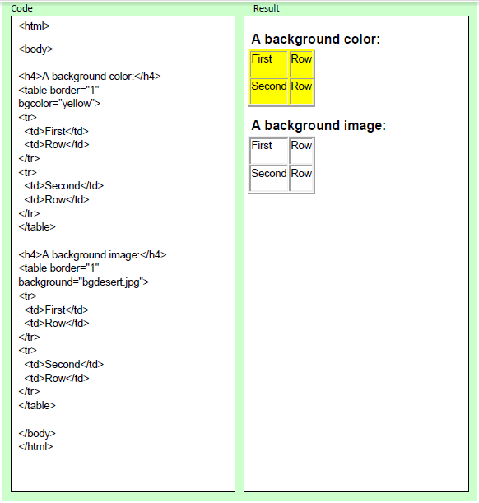
Outline
Examples
This example demonstrates how to add a background to a table.

Slide 15

THANK YOU

